Slide 1
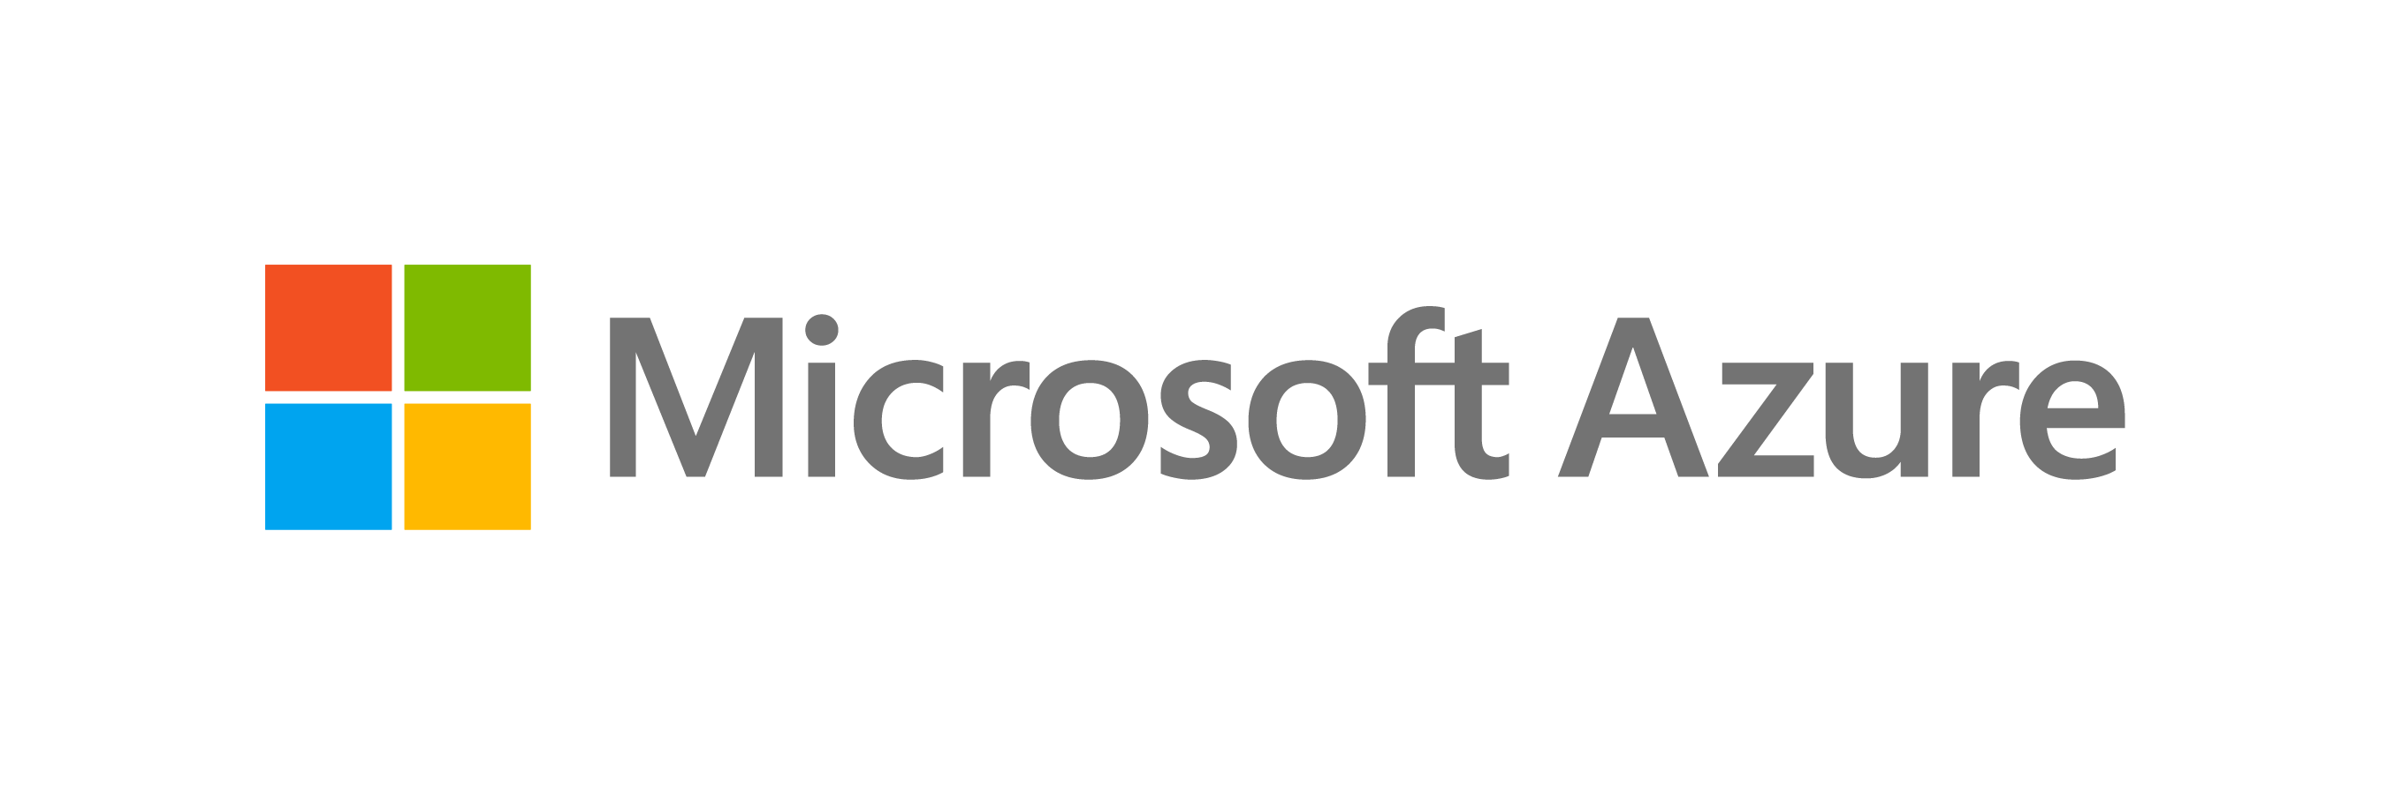

Cloud Transformation
Sarah Lean
Cloud Solution Architect – Datacentre Migration Specialist
@TechieLass

Slide 2
Software and hardware refresh
Security threats
Urgent capacity needs
Compliance
Quickly integrate acquisitions
Application innovation
Migration & modernization triggers
Software end of support
Datacenter contracts expiry
Sarah Lean @Techielass
Notes:
2 patterns:
Look for and listen deeply to your customers’ migration/modernization triggers. That will help you position appropriate urgency around migration.
Situations like end of support, DC lease expiry, acquisition integration signal time-bound deadlines.
App innovation might be tops down driven and needs to be dealt with strategically.

Slide 3
EOS presents opportunity to modernize your infrastructure & avoid business risk
2008 | R2
No security updates
Compliance &
regulatory concerns
Windows Server
Ends January 14, 2020
$
Additional cost for support + patches
Missed innovation opportunities
SQL Server
Ends July 9, 2019
Sarah Lean @Techielass
Find lifecycle support deadlines at: support.microsoft.com/lifecycle

Slide 4
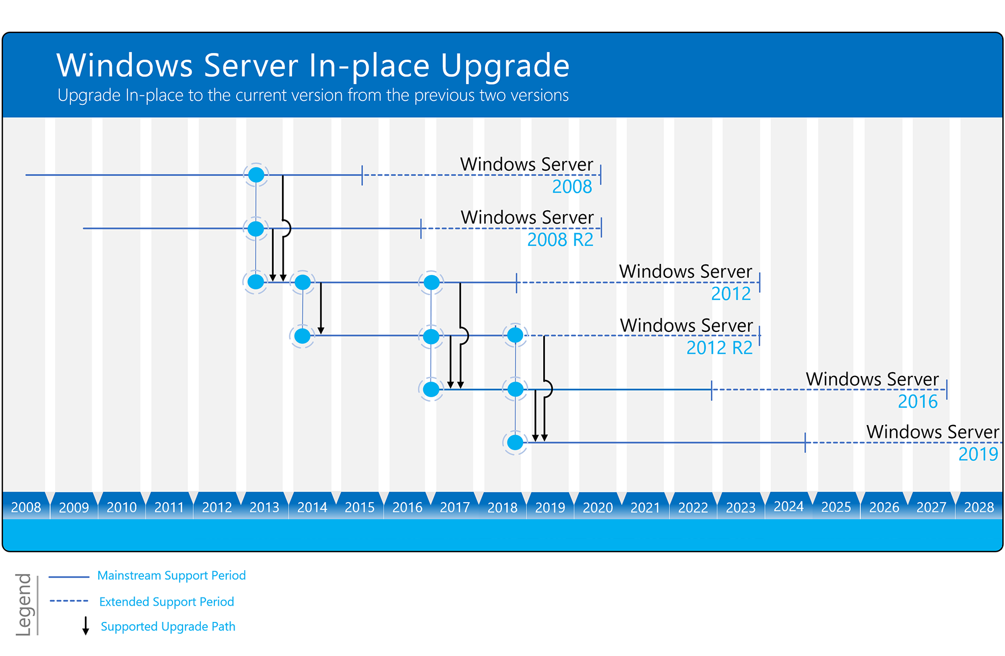
https://www.microsoft.com/upgradecenter

Slide 5
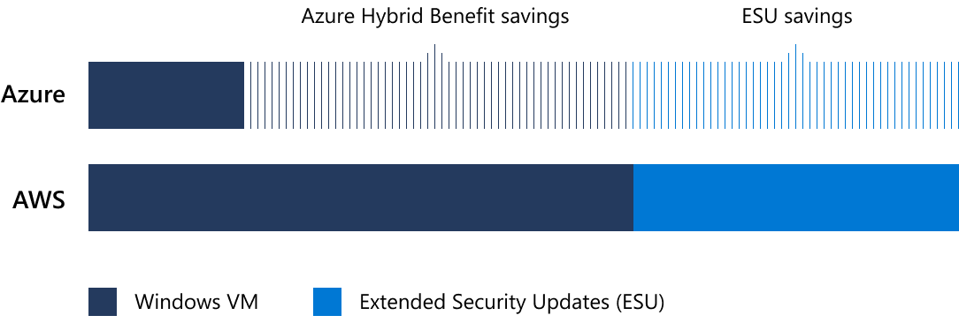
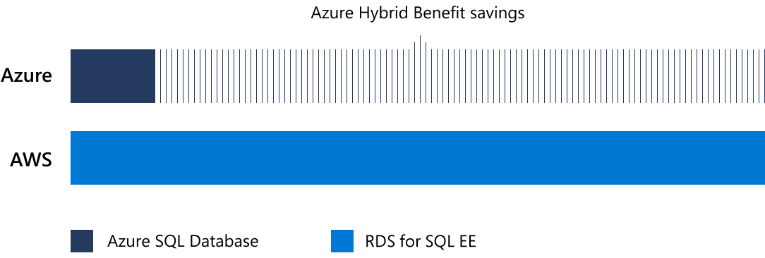
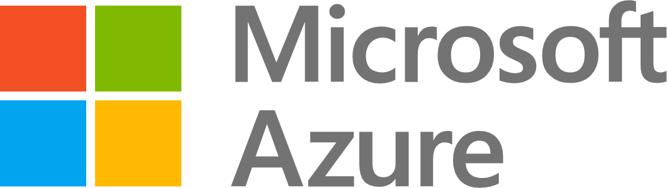

Extended security updates, free only on Azure
Windows Server savings illustration
Pay less with Azure. AWS is 5x
more expensive.
Other cloud service providers may claim to have similar savings to the Azure Hybrid Benefit, but you’ll need to repurchase your Windows Server license on those clouds. And only Azure offers free extended security updates for Windows Server 2008 and 2008 R2.
3 years of security updates after support ends
75% of the license cost to buy standalone
Reuse existing licenses with Azure Hybrid Benefit
SQL Server savings illustration (PaaS)
Only Azure offers savings across both platform-as-a-service (PaaS) and infrastructure-as-a-service (IaaS) for SQL Server. With the Azure Hybrid Benefit, you can use existing licenses with Software Assurance to pay a reduced rate on Azure SQL Database (PaaS). This is not included in SQL Server license mobility rights for other clouds.
Sarah Lean @Techielass
Learn more: aka.ms/why5xmore
Notes:
Now I am going to touch on a specific migration trigger which is also a area of differentiation vs. AWS.
WS/SQL EOS migration. Migrating WS/SQL is a very critical motion and we shouldn’t lose any of our workloads to AWS.
Think of this as a door opener or conversation starter (time bound and we have AWS differentiation)

Slide 6
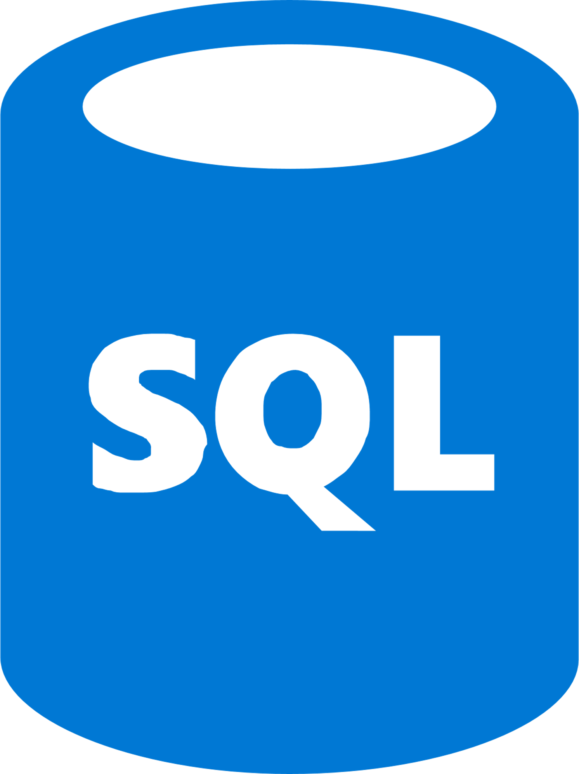
Azure is the best destination for Windows Server and SQL Server
Unique hybrid experiences: Server + Azure
Unparalleled consistency & innovation: Azure SQL Database Managed Instance
Deep trust with
enterprises
Azure Security Center + built-in OS security
Windows Admin Center
Integrated backup, disaster recovery, & identity
Full parity with 100% code consistency
Unmatched support & backward compatibility
Machine learning-based performance & security
More certifications than other providers
Single vendor support
Reuse familiar skills and toolsets
Sarah Lean @Techielass
Learn more: Windows Server on Azure | SQL Server on Azure
Notes:
***Remove the “Learn more” row on the slide when you present to customers – that is an internal reference for you.**
We also heard that you need proof of our workloads run better on AWS vs. Azure.
We are unequivocally the best for WS/Azure hybrid experiences.
We are unparalleled in the level of consistency and compatibility that MI offers for SQL Servers.
Finally, don’t underestimate the trust and relationships that we as Microsoft have with enterprise customers. AWS would kill to have that.

Slide 7
Migration/ Modernization strategies, projects, and innovation
Sarah Lean @Techielass

Slide 8
Azure migration & modernization scenarios
App
Migration & Modernization
Cloud-native
SaaS
On-premises
Data
Rehost
Refactor
Rearchitect
Rebuild/New
Replace
Infrastructure
Virtual Machines
Containers
App, Data, & AI Services
Security | Management
Sarah Lean @Techielass
Notes:
These are the Azure migration scenarios and associated technologies. These scenarios are based off of an industry standard framework.
Rehost: Redeploy as-is to cloud; used for quick ROI, freeing up DC space, least effort. IaaS is the key tech here.
Refactor: Minimally alter to take better advantage of cloud; used for code portability and quick updates. Containers and PaaS are the key tech here.
Rearchitect: Materially alter/decompose application to services; to enhance app scale and agility. PaaS, Serverless and Microservices are key tech here.
Rebuild: New code written with cloud native approach; to accelerate innovation and build apps faster. PaaS, Serverless and Microservices are key tech here.

Slide 9


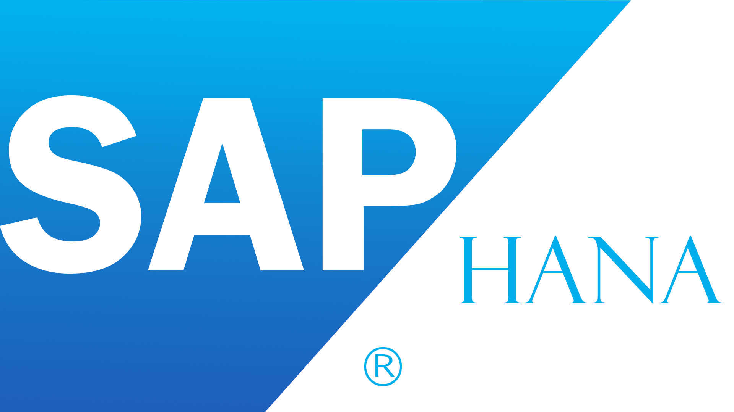
Common Azure migration/modernization projects
Windows Server
File servers, containers, AD/DNS/DHCP
SQL Server
Application databases, Analytics (BI, DW)
ASP.NET/ PHP/ Java apps
Customer facing & internal LoB
Linux/ Open source databases
(e.g., RedHat/SUSE, Hadoop, MySQL,
PostgreSQL, NoSQL)
SAP
Specialized workloads
e.g., HPC, NetApp
Sarah Lean @Techielass
Notes:
The next question you may have is – can you get specific on what are some of the common projects that we’ve come across?
The first row and Linux are more high volume tranches…but SAP and HPC are specialized yet Strategic.
Still with me?

Slide 10
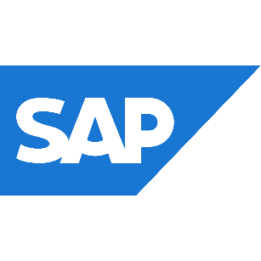







Reliable infrastructure to rehost any workload
On-demand
Purpose-built
Linux, Open Source, and Red Hat
Best for Microsoft workloads
+40%
Unique hybrid experiences: Server + Azure
Compute
of Azure VMs are running Linux
1.4x
Unparalleled consistency & innovation: Azure SQL DB Managed Instance
Networking
growth of Linux
Co-located support with Red Hat on-site team
Deep trust with enterprises
Storage
Sarah Lean @Techielass
Notes:
What do we mean when we say “modern infrastructure”?
Azure IaaS offers a purpose-built IT infrastructure designed to fit your company’s needs, rather than the other way around
This is accomplished through utilizing the experience we’ve gained in a 300,000-plus partner global ecosystem, which is 5 times greater than Google’s partner network.
Microsoft also has deep experience with many different kinds of industries
Our global data centers offer you support for all your applications when and where you need it
We are differentiated from our competitors by offering a first-class experience that has been recognized by such partner certifications as SAP and Red Hat
And we can tailor our support for any specialized needs you may have—regardless of whether you are managing on-premises, hybrid, or cloud-only infrastructures
Purpose-built infrastructure
A combination of virtual machines and purpose-built large instances provides the largest scale and widest range for your workloads.
With an on-demand infrastructure, you and leverage per-minute billing and scale your CPU and RAM usage up or down based on your application workloads.
However, for large instances, on-demand infrastructure can be cost prohibitive. That’s why Azure offers purpose-built infrastructures, which allow you to customize your infrastructure based on your specific workload needs.
Linux and Open Source
… which is why we provide the hardware for Windows and Linux platforms …
Given Microsoft makes Windows Server, there is no better place to run Windows platforms than on Windows Server. They were, quite literally, made for each other.
But, we don’t stop at Windows …
33% of our partners are running Linux.
Which is why Microsoft has established relationships with big Linux providers.
In fact, Microsoft is doing something the industry has never seen before … we’ve developed an integrated support model with Red Hat support sitting with our support teams in Redmond.
“Red Hat really impressed us with its enterprise grade support. We were surprised that Red Hat open source and Azure support resided in the same office. ” —Richard Hum: Studio Head —Throwback Entertainment
Best for MS workloads
Gain unparalleled cost savings
Save up to 73% compared to AWS RIs*
+4000 certified partner solutions in Azure market place

Slide 11
Azure migration journey and tools
Sarah Lean @Techielass

Slide 12
Unified and extensible Azure migration experience
Assess
Migrate
Optimize
Secure and manage
Migration tools | Azure migration center | Scenario guidance | FastTrack for Azure | Azure Expert MSPs
Azure Fundamentals
Target architecture | Governance | Connectivity | Security | Training & Readiness
Sarah Lean @Techielass
Notes:
Summary:
Key phases of the Azure migration experience – workload assessment and discovery, workload migration, ongoing optimization (Cost Management, AHB, RI) and security/management (built in services – backup, monitoring, blueprints etc.)
Key investments – tools, prescriptive guidance, and handholding
3) Foundational best practices which are critical enablers to help you scale up your efforts – skilling up people, investing in the right processes – e.g., biz case/exec support, mix of migration strategies, tracking migration), and tech (governance, networking, identity, security and management tools)
___________________________________________________________________________________________________________________
Details
1) The figure above shows the Azure migration experience. Let’s walk through the key phases of this experience.
Assess
This phase is about discovery and assessment of on-premises resources for Azure migration. Azure Migrate is our free, built in tool for infrastructure assessment.
Migrate
This phase is about defining and executing migration and modernization strategies – rehost, refactor, and rearchitect. We have great tools like ASR and Azure DB Migration Service to help with reshooting. And then we have some great Azure capabilities to help customers refactor and rearchitect their apps.
Optimize
Many customers look to the cloud to gain operational efficiencies and cost savings. With Azure Cost Management , customers can now manage their cloud spend in a unified experience, and leverage built-in best practice recommendations (e.g., turning off idle VMs) to drive operational efficiency. They can apply Azure Hybrid Benefit and Azure Reserved Instances during or after migration for big savings.
Secure and Manage
We understand that securing and managing migrated resources is critical, both during migration and on an ongoing basis. With Azure security and management , customers can take advantage of built-in intelligent services for their Azure and on-premises workloads. We highly recommend turning on Azure Security Center, Azure Backup, and Azure Log Analytics right after the resource is migrated, followed by fine-tuning over time.
2) To support these phases, we have some great investments:
Migration tools (like I mentioned)
Azure migration center (single place for all things migration)
Step by step scenario guides
FastTrack for Azure for handholding by MSFT
Azure Expert MSPs which is a group of highly skilled Azure partners to help you.
3) Finally, we recommend a set of best practices based on our learnings from helping customers in real world migration projects. These include skilling up your people, investing in the right plans and processes (e.g., biz case for migration, migration strategy planning, tracking migration progress), and having tech pre-reqs in place (network, identity, security, management, governance).
We will have a lot more detail on these in subsequent sessions.

Slide 13




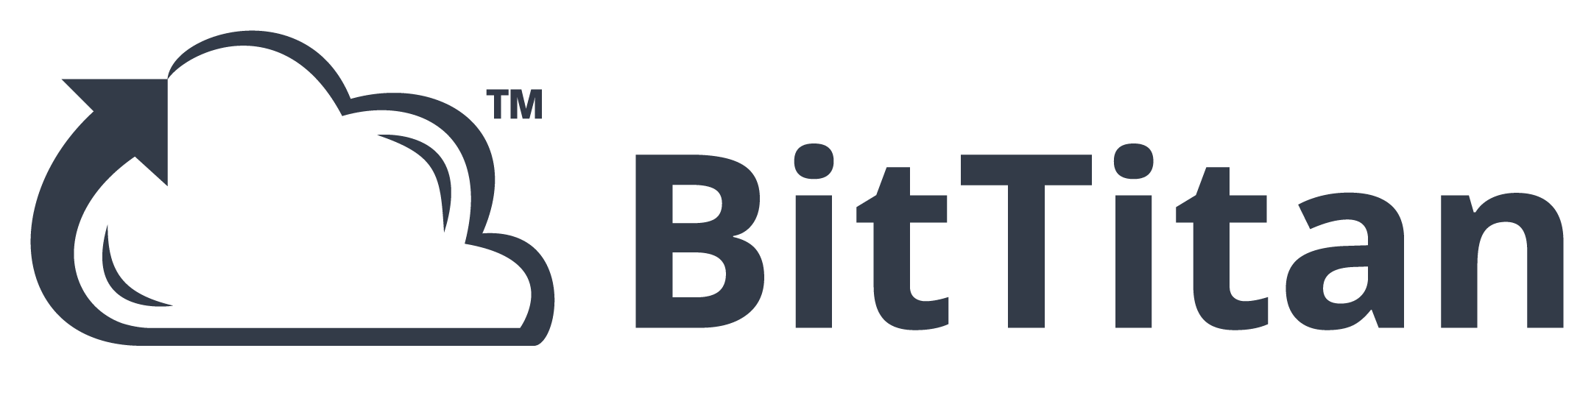
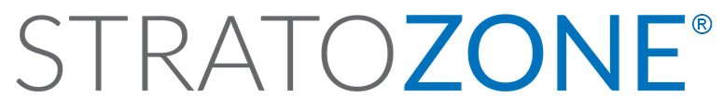
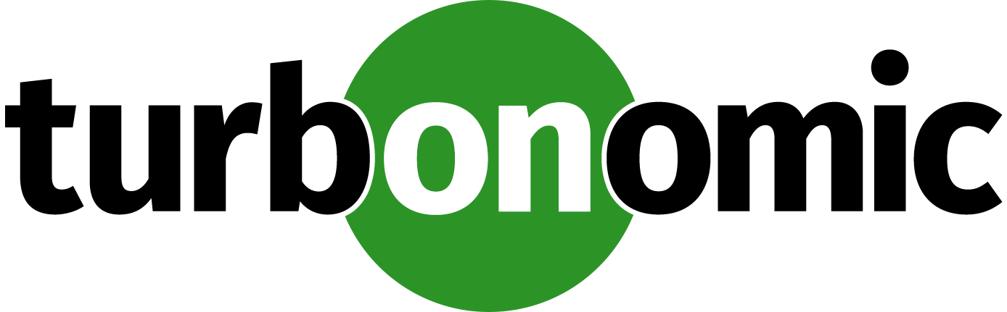

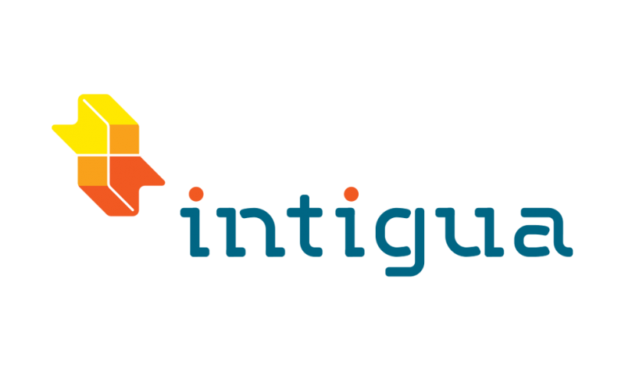

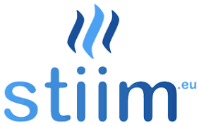





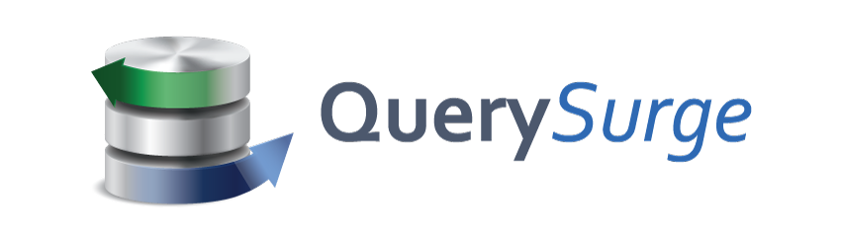
Choice of tools for every stage and every requirement
Goal is successful Azure migration: Pick the right tool for the job
Assess
Migrate
Optimize
Secure & Manage
Azure Migrate
Azure Site Recovery (ASR)
Azure Cost Management
Azure Advisor
Azure Security & Management
(e.g., Blueprints, Security Center, Backup, Monitor)
Data Migration Assistant (DMA)
Azure Database Migration Service
SQL Server Migration Assistant (SSMA)
Azure Data Box
We embrace ISV solutions
Sarah Lean @Techielass
Notes:
Our goal is to enable successful Azure migration, regardless of what tool was used.
We have a great set of first party Azure tools that are built into the Azure portal and free to get started.
But we also have a great set of third party tools to meet all your requirements. For example: Cloudamize, Movere, Turbonomic, TSO Logic can discover a broader set of environments than Azure Migrate does today. Similarly, tools like Zerto and Cloud Endure can migrate a broader set of OS’es to Azure as compared to Azure Site Recovery.
We’re also working closely with the ecosystem to build out a unified experience across Azure and 3rd party tools.

Slide 14





Azure Fundamentals: Governance
Governance becomes very critical as you scale Azure migration efforts
NEW
NEW
NEW
Management Group
Policy
Blueprints
Resource Graph
Cost Management
Define organizational hierarchy
Real-time enforcement, compliance assessment and remediation
Deploy and update cloud environments in a repeatable manner using composable artifacts
Query, explore & analyze cloud resources at scale
Monitor cloud spend and optimize resources
Hierarchy
Control
Environment
Visibility
Consumption
Sarah Lean @Techielass
Notes:
Azure governance consists of 5 capabilities (Policy, Blueprints, Resource Graph, Management Group, Cost Management) to ensure you will have the right tools for your applications or workload teams, so they can use cloud resources in an accountable & responsible fashion.

Slide 15
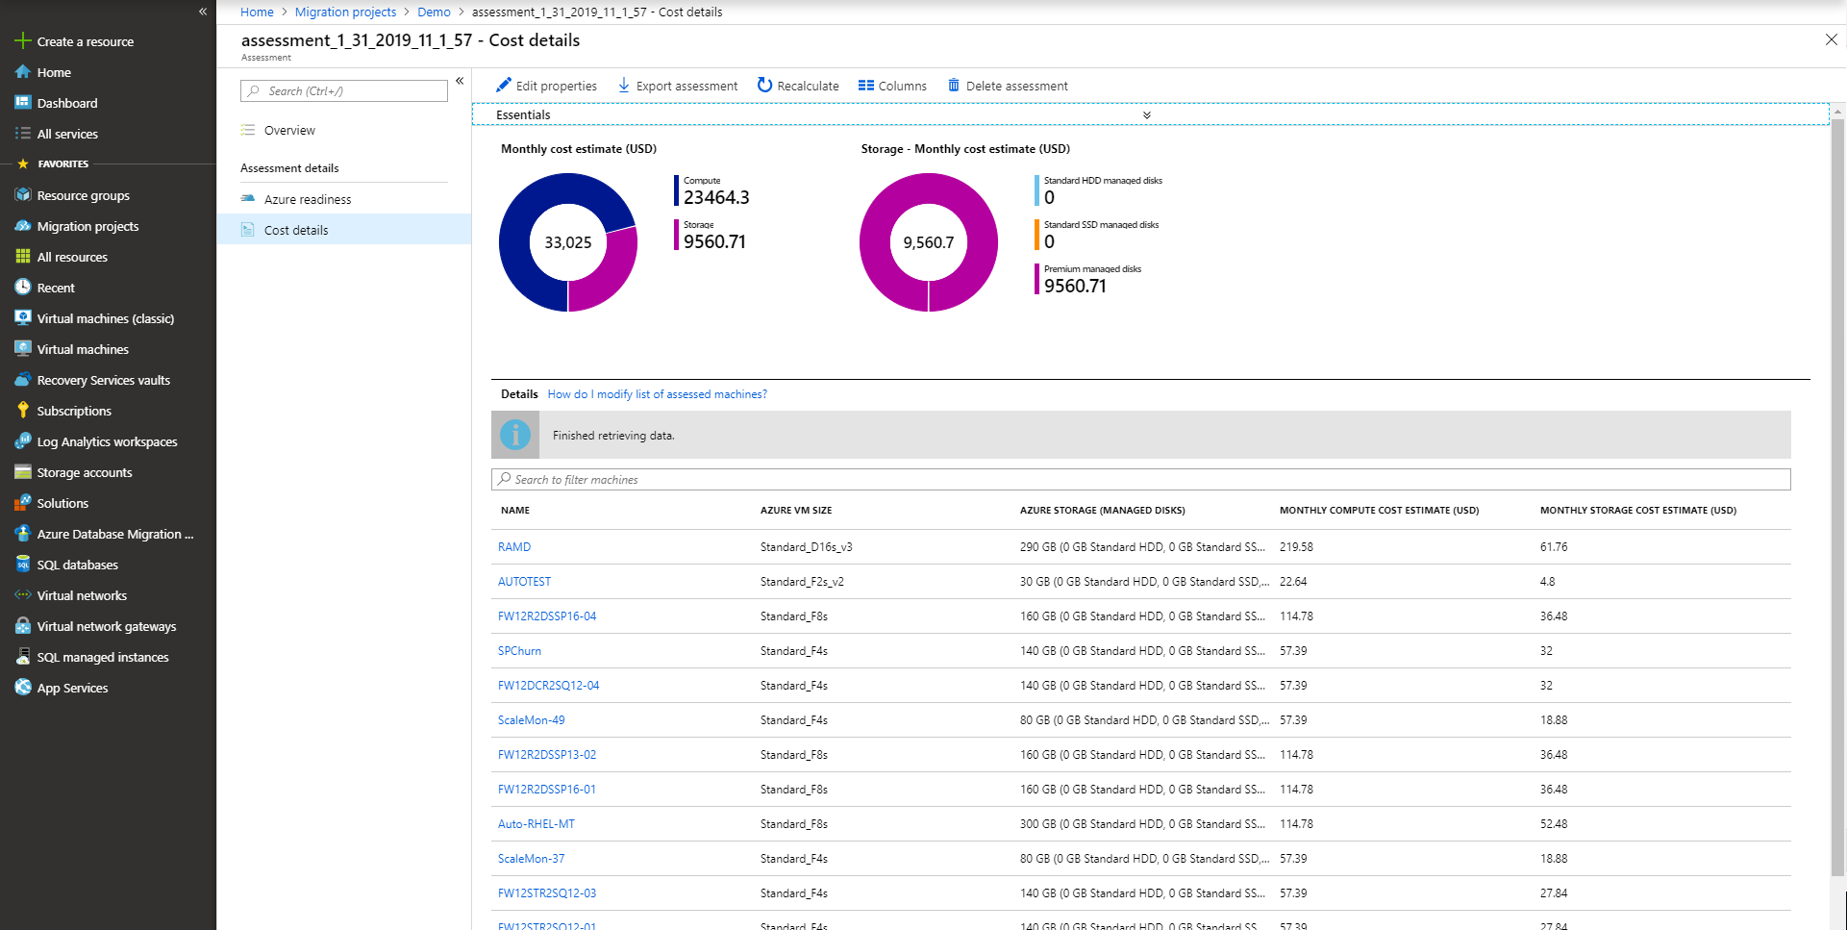
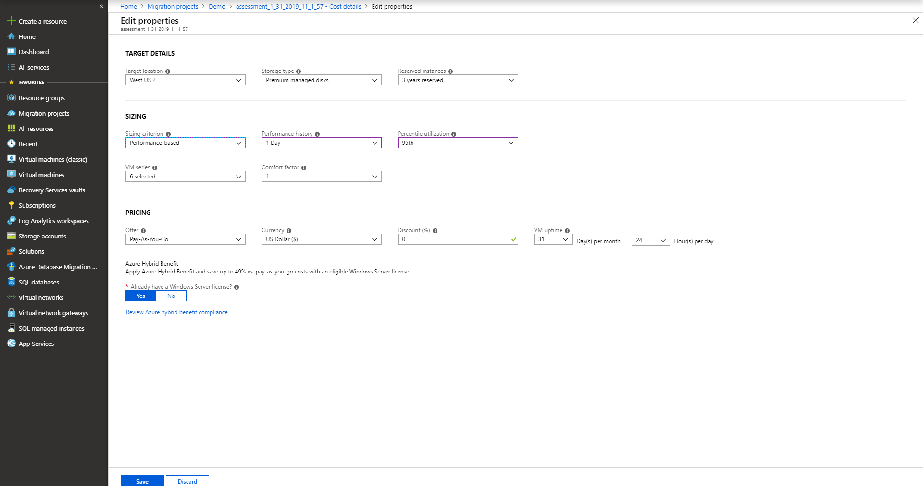

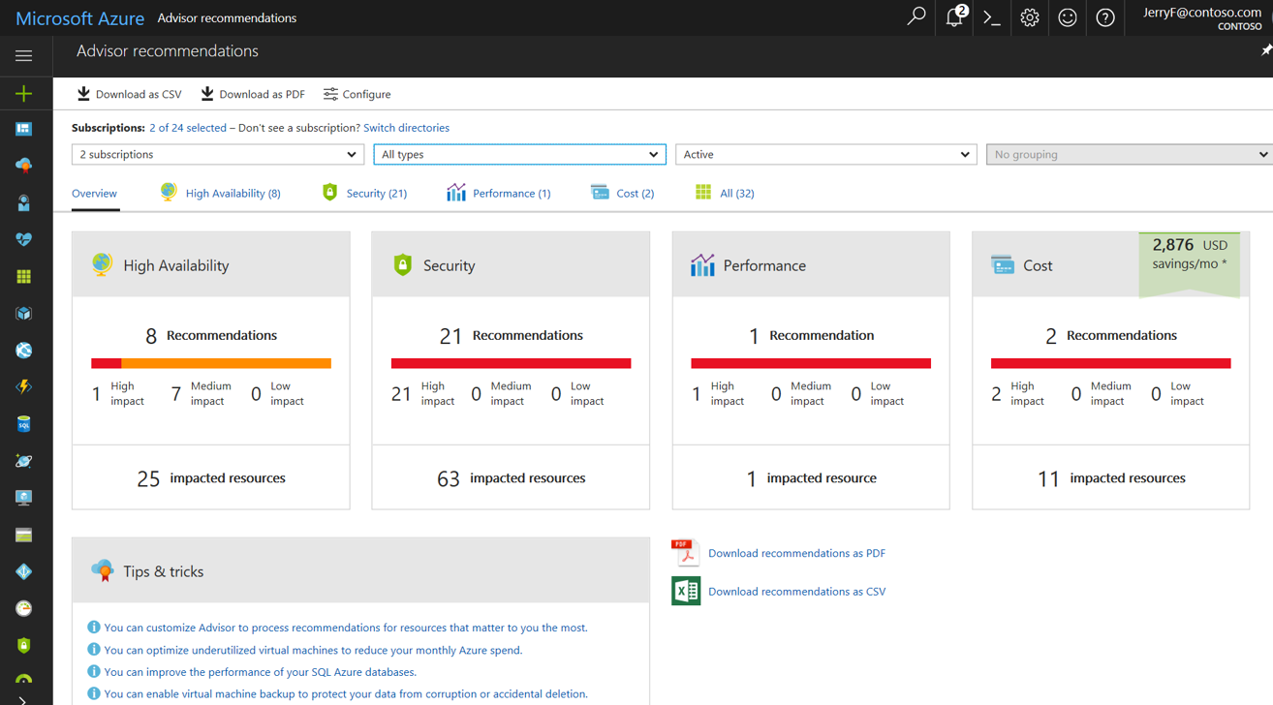
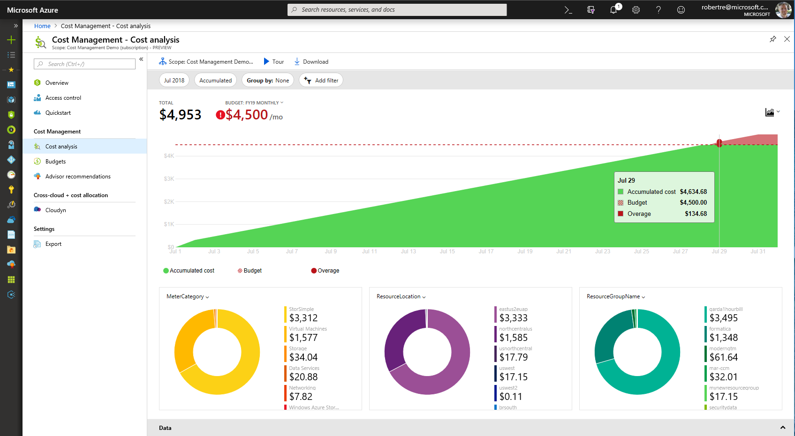
Continuously optimize resources during and after migration
As you move
Right-size Azure resources based on assessment guidance
Use Azure Hybrid Benefit and Azure Reserved Instances to save money
After you move
Unified experience to optimize cloud spends: Azure Cost Management
Azure Advisor: Built-in best practice recommendations
(e.g., turn off idle VMs)
Modernize for longer term value
Sarah Lean @Techielass
Notes:
Let us now transition to the Optimize phase in the Azure migration journey.
Many customers look to the cloud to gain operational efficiencies and cost savings. With Azure Cost Management , customers can now manage their cloud spend in a unified experience, and leverage built-in best practice recommendations (e.g., turning off idle VMs) to drive operational efficiency. They can apply Azure Hybrid Benefit and Azure Reserved Instances during or after migration for big savings.
Link to blog

Slide 16
Key resources and investments
Sarah Lean @Techielass

Slide 17
Key elements to successful migrations
Migration approach
Migration Tools
Offers
Migration partners
Training
Sarah Lean @Techielass
Notes:
5 things that are key elements to drive a successful migration project.
We already spoke about tools so I will touch on the others. Lots of resources linked here for offline stufy.

Slide 18
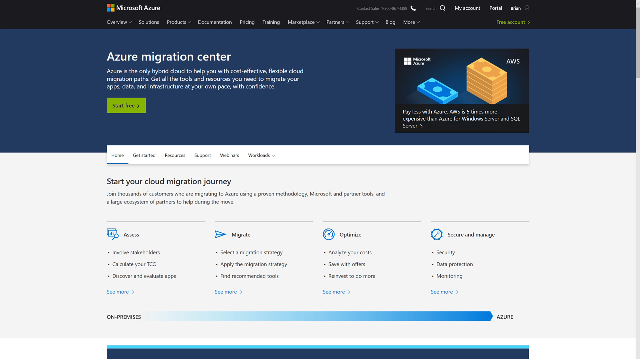
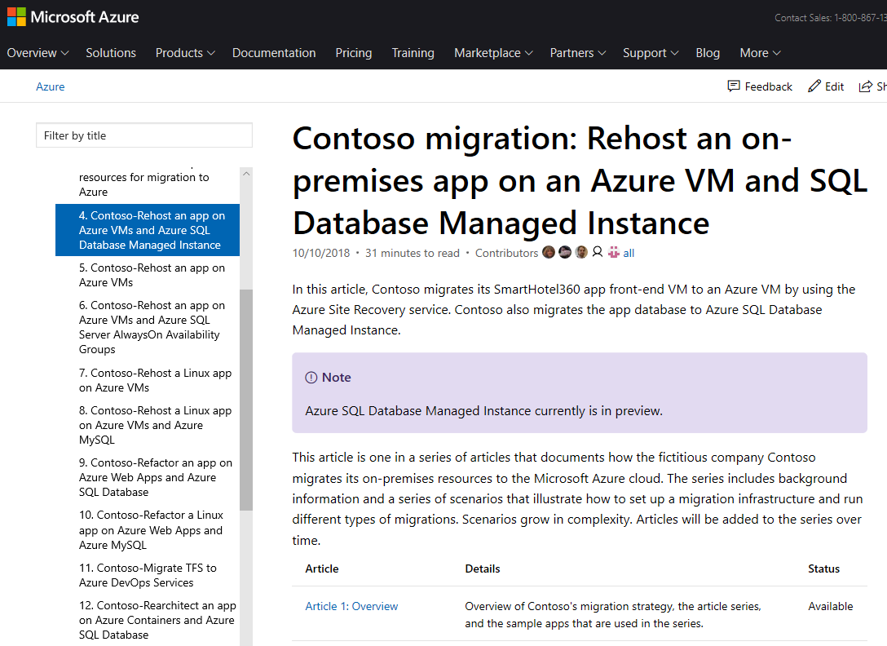
Migration approach
All things migration
(guidance, tools, support)
Detailed walkthrough of different migration scenarios
Azure.com/Migration
aka.ms/contoso-migration
Sarah Lean @Techielass
Notes:
Azure migation center is your one stop destination for all things migration

Slide 19
Microsoft Cloud Adoption Framework for Azure
Best practices
Templates
People
Process
Technology
Documentation
Tools
Achieve balance
Align business, people and technology strategy to achieve business goals with actionable, efficient, and comprehensive guidance to deliver fast results with control and stability.
https://aka.ms/caf
Sarah Lean @Techielass

Slide 20
Azure Migration Program (AMP)
Available to all Azure customers, scaled through specialized migration partners
Best practice guidance
Offers and incentives
Technical skill building
Infrastructure and data foundations
Migration planning and execution
FastTrack for Azure engineers
Digital resources
Migration
Tools
Azure trainers
FastTrack for Azure engineers
Specialized partners
Reduce cost and risk | Accelerate migration velocity | Deliver customer success
Learn more | Azure.com/AMP
Sarah Lean @Techielass
Notes:
The Azure Migration Program gives you prescriptive guidance for a step by step approach to cloud migration. AMP offers the opportunity to work closely with Microsoft experts and specialized migration partners to simplify and accelerate your migration.
The program delivers:
Technical skill building to ensure your organization can successfully adopt Azure
Best practices for a step by step approach from start to finish
Azure engineering support for data and infrastructure foundations
Expert guidance from specialized migration partners
Free Azure tools to help you efficiently execute migrations
And cost effective offers to help you save money before, during, and after migration

Slide 21
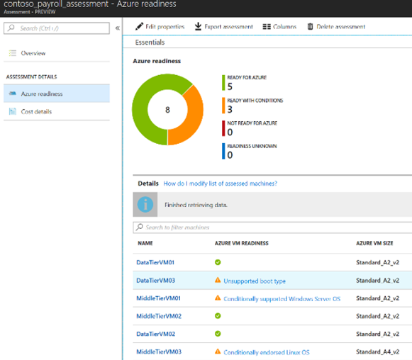
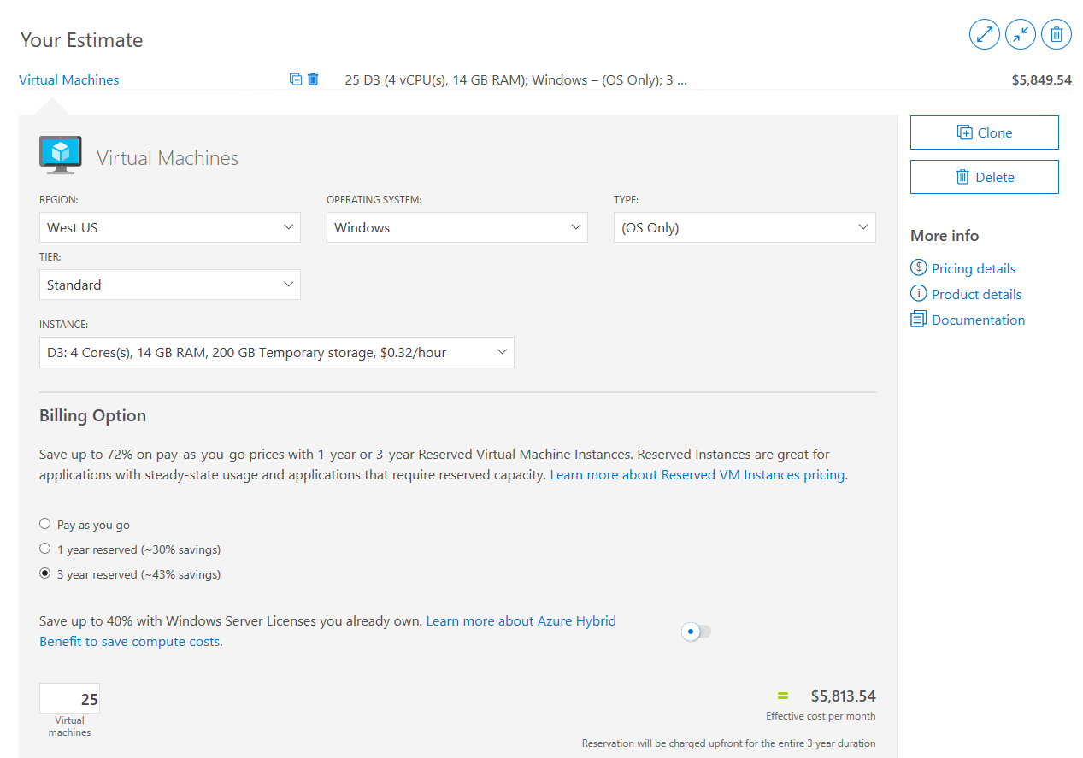
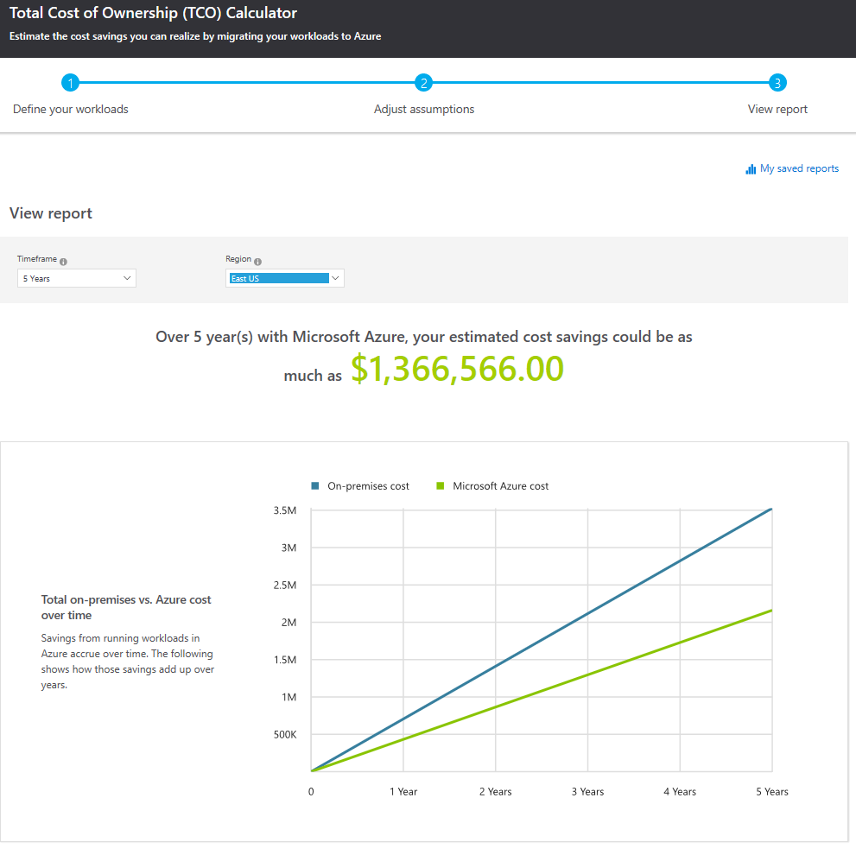
Best practice example: Building a cloud business case
Gather Inventory
Azure Migrate or Partner Tools
Azure Pricing Calculator
Configure and estimate costs for Azure products
azure.com/pricing/calculator
Azure TCO Calculator
Estimate on-premises costs vs. Azure
azure.com/tco
Sarah Lean @Techielass
Notes:
Use Azure Migrate or Partner tools to get inventory
<click>
Use a true inventory when calculating the costs. Don’t guess!
<click>
Calculate the TCO. Make sure to look at licensing and leverage Hyper use Benefits for Windows and SQL along with Reserved Instance to save up to 80% on cloud spend.

Slide 22



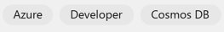
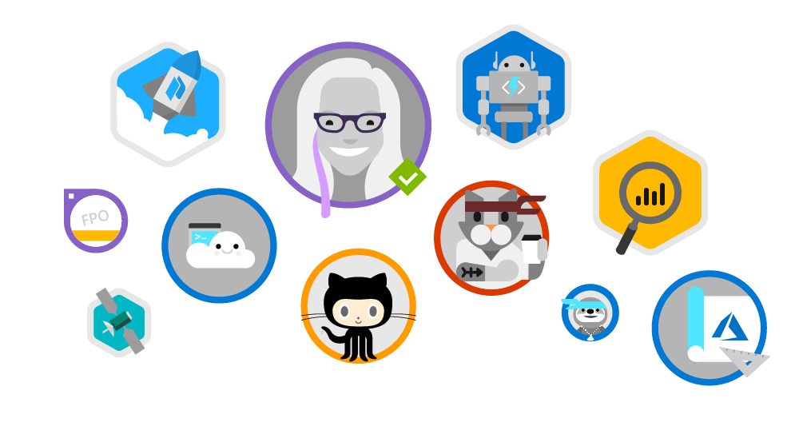
Microsoft Learn
www.microsoft.com/learn
Step-by-Step Learning
Gamification & Achievements
Friction-Free Learning
Guided microlearning by product/service, difficulty, job role, etc
Videos, tutorials, and hands-on learning
Role-based learning paths to prepare for certification
Unlock achievements
Task-based achievements to reward your hands-on skills
Customizable user profile
All learning content is free
Content available in the spoken language and programming language of my choice
No-install, browser-based Interactive coding/scripting environments
All scripts and code samples available for download
Sarah Lean @Techielass

Slide 23
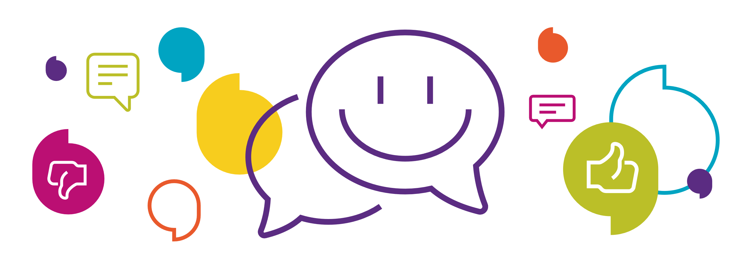
https://aka.ms/sarahfeedback

Slide 24
https://aka.ms/sarahfeedback
Thank you | Q&A
@TechieLass

